Slide 1
Vanguard-WSN: 10.21x Lifetime Extension via Utility-Driven Routing
Addressing the 'Energy Hole' Gap with Deterministic Tree Models

Slide 2
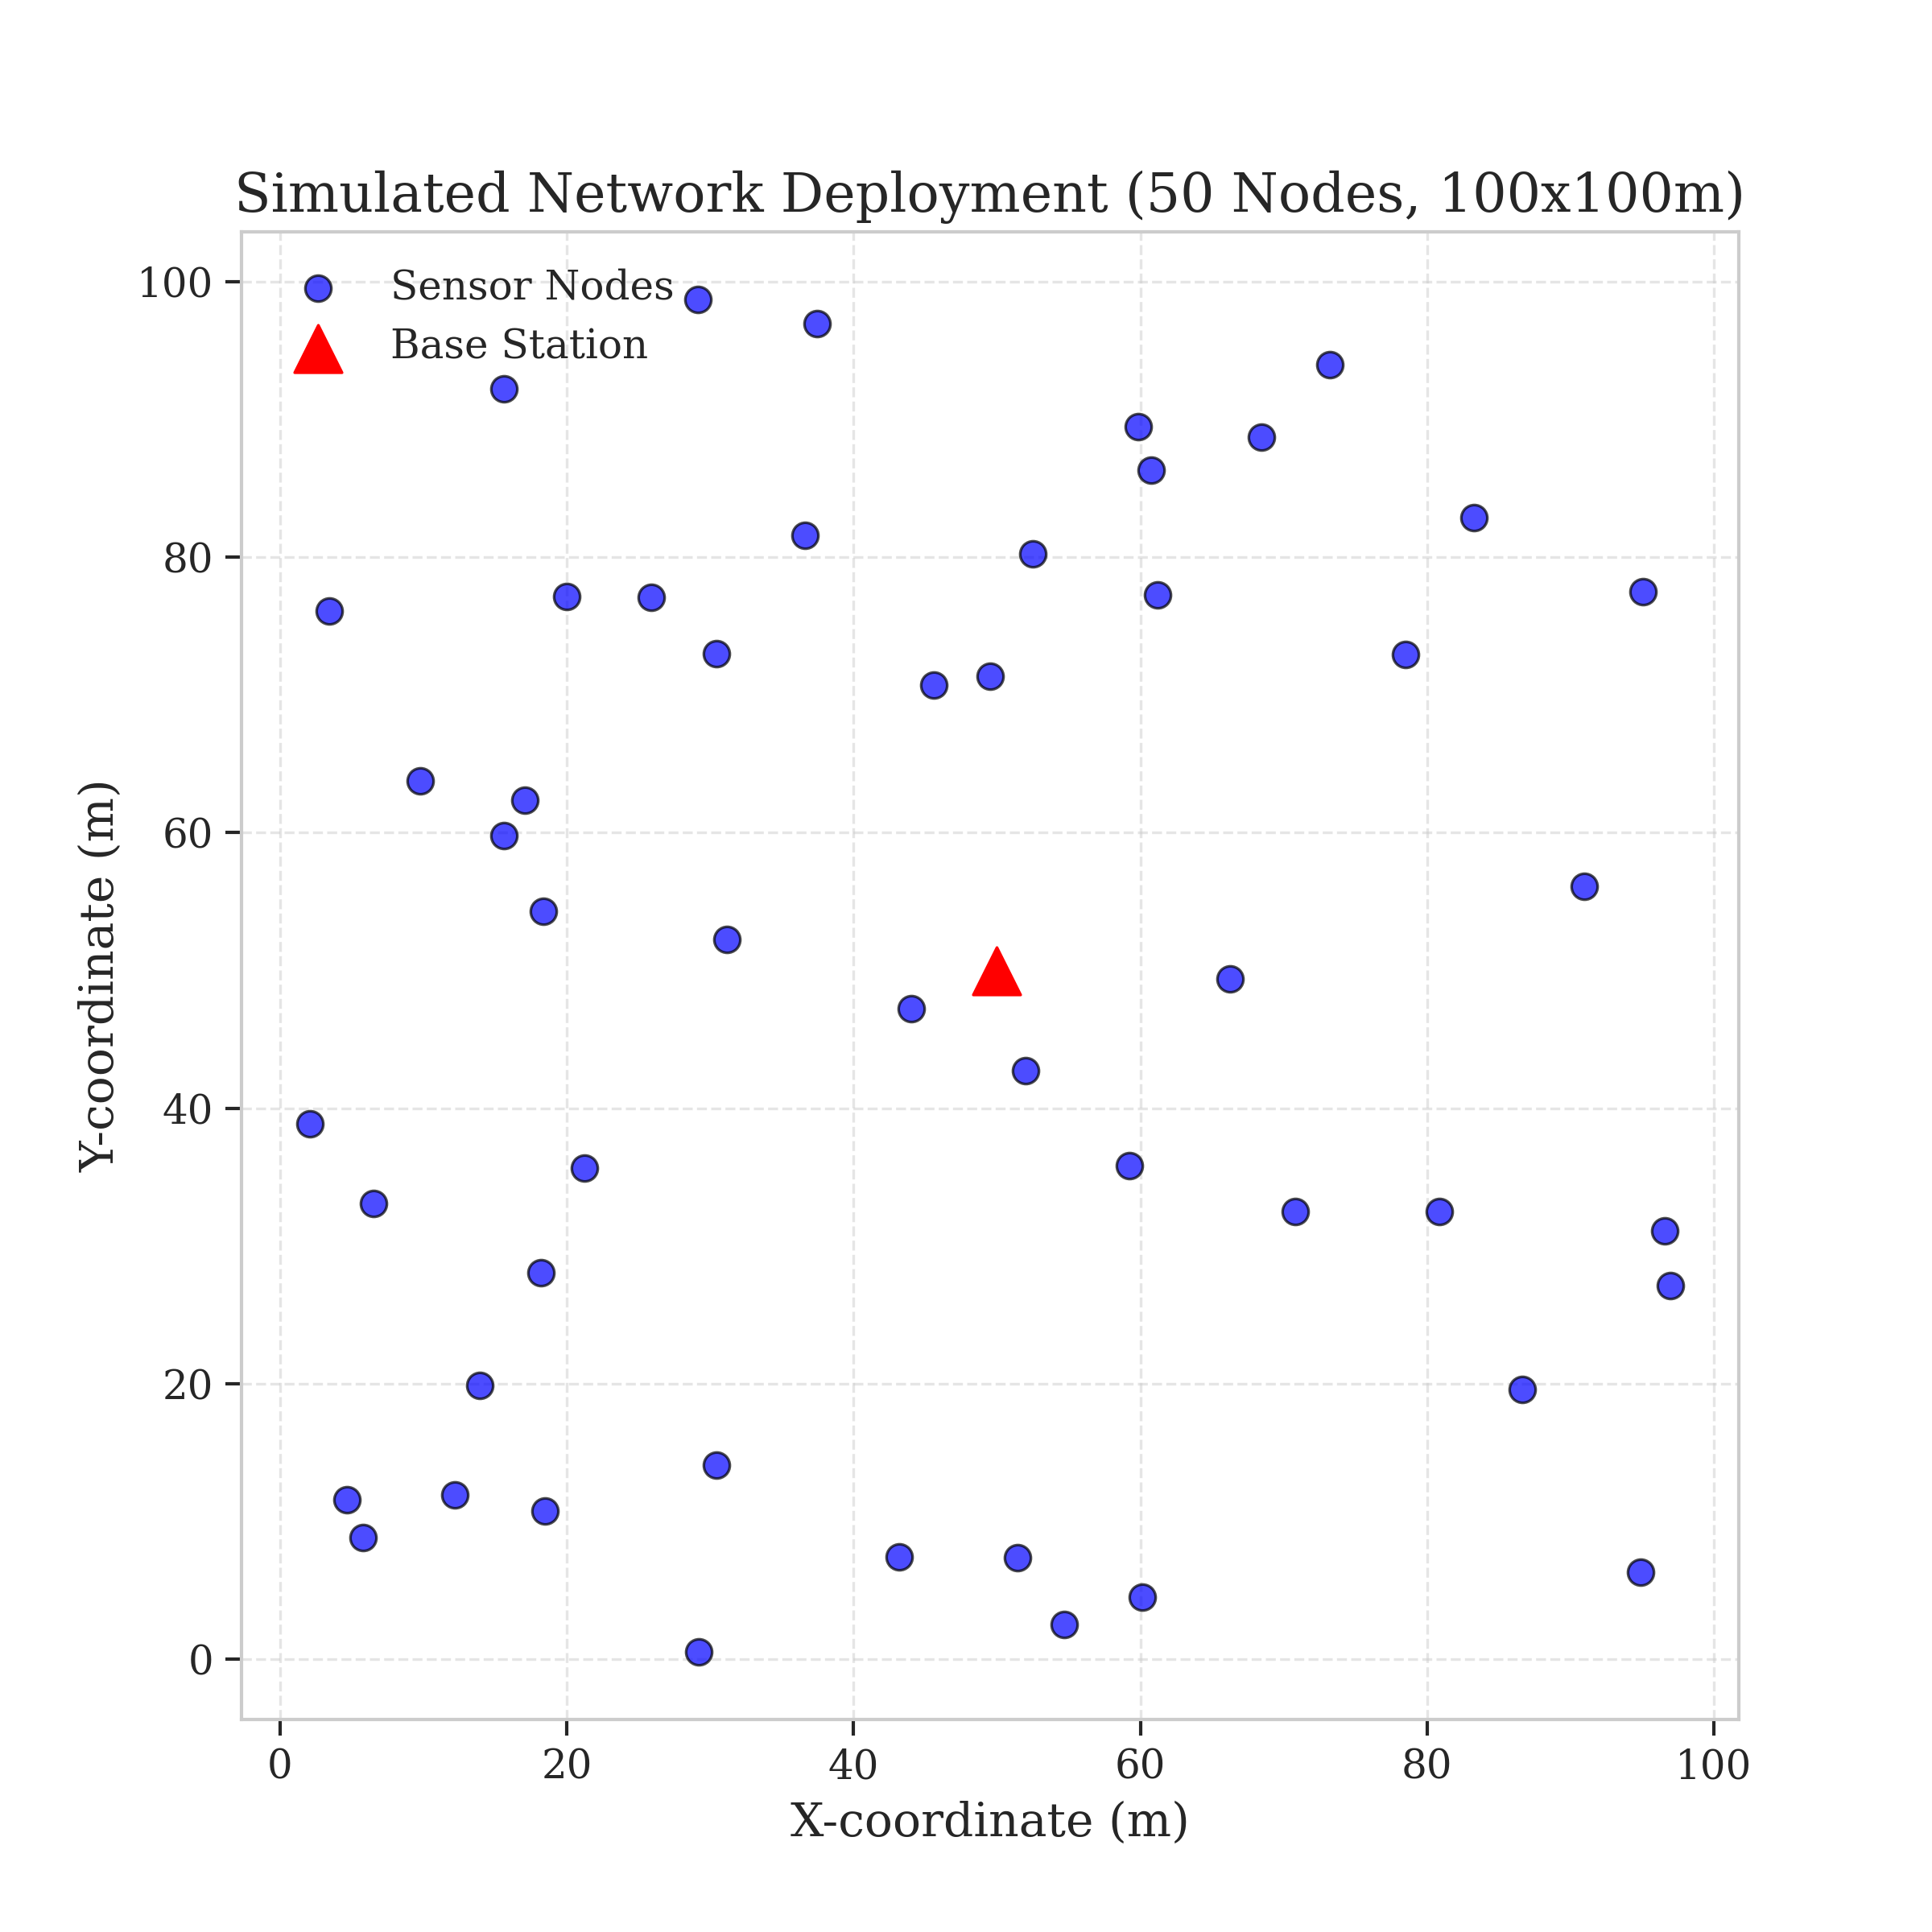
1. Problem and Objectives
The Problem: Energy Hole Phenomenon (Relay Burnout).
Legacy Failure: Randomized protocols (LEACH) pick weak leaders.
Systemic Collapse: Edge nodes die despite having 80% battery.
Objectives: Replace chance with deterministic logic.
Target: Maximize Network Stability (FND) and Data Throughput.
Goal: Approach the Theoretical God-Line (LP-Bound).
Figure 2: Spatial Deployment and Relay Vulnerability

Slide 3
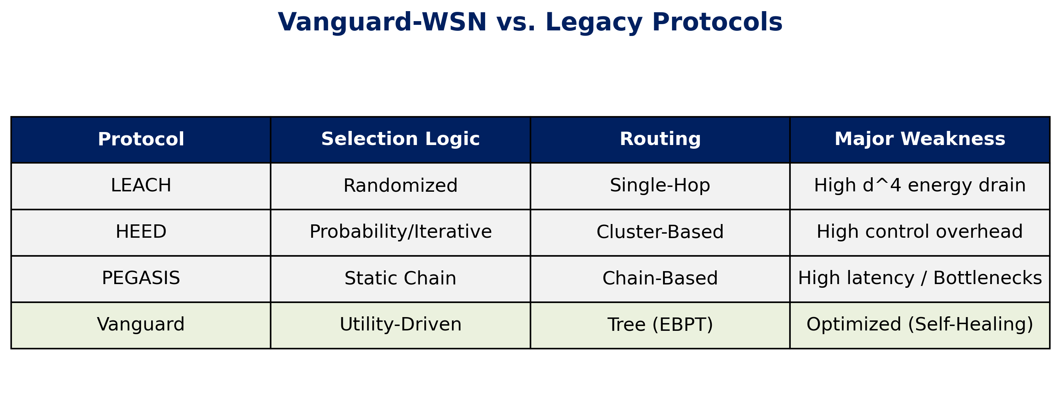
2. Literature Survey: Comparative Gaps
Gap Analysis: Why LEACH/HEED/PEGASIS fall short

Slide 4
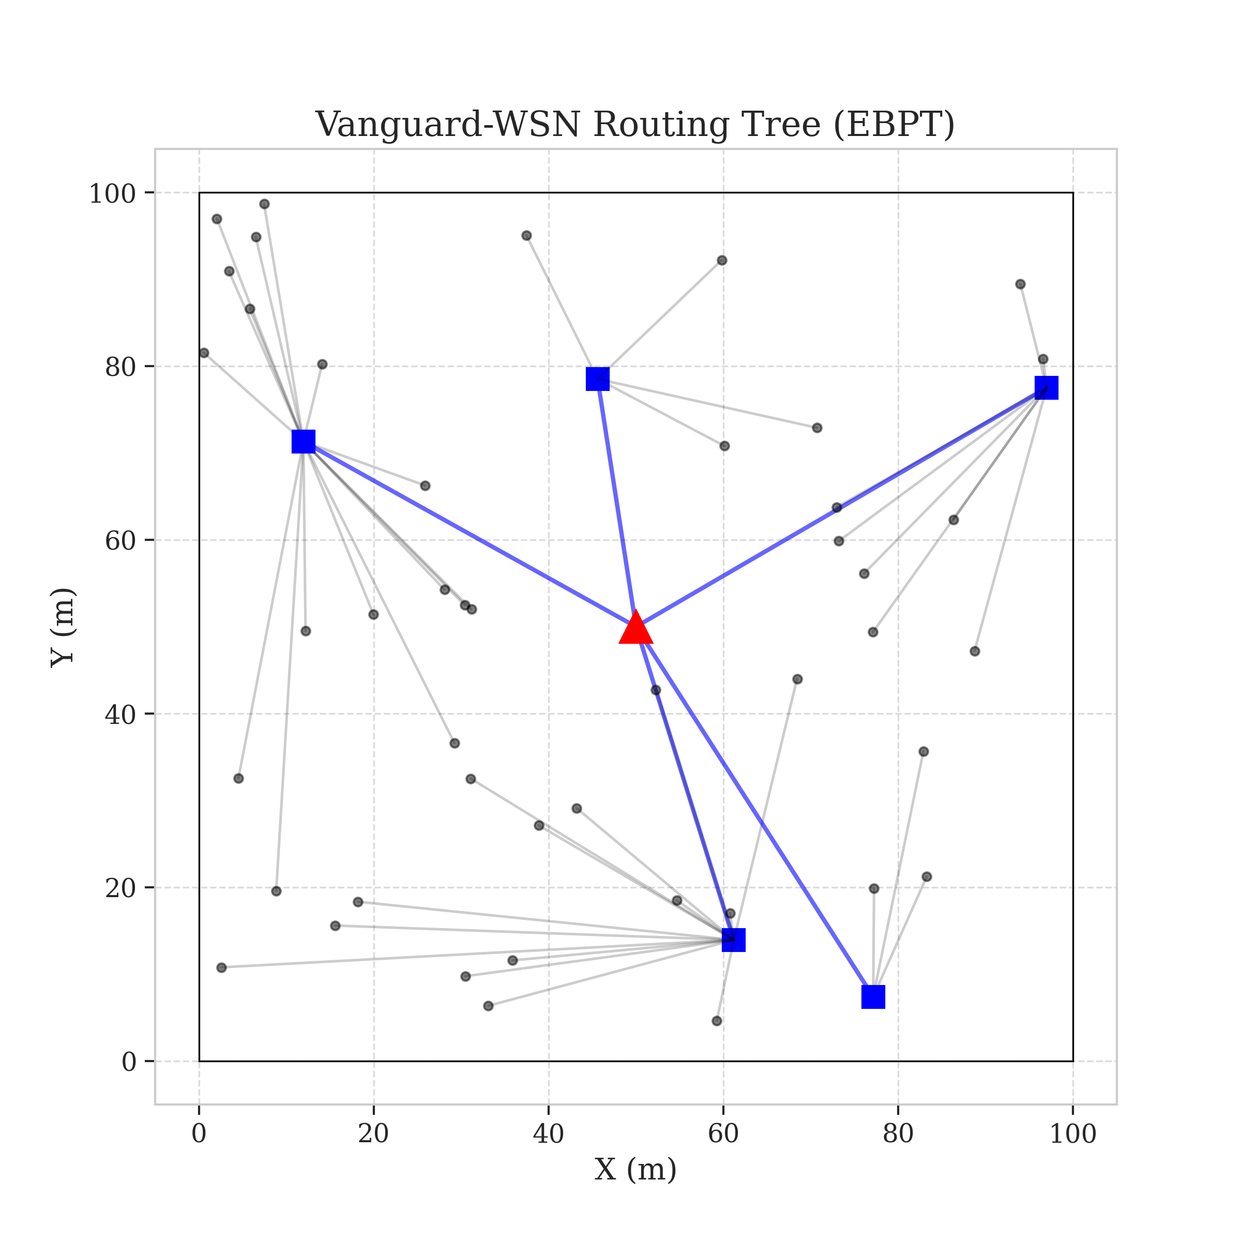
3. Flow Diagram: System Operation
1. Initialization
BS Placement
2. Heartbeat
Health Check
3. Control Plane
Utility Selection
4. Routing
EBPT Construction
5. Transmission
Data Relay
Figure 3: Resulting Energy-Balanced Path Tree

Slide 5
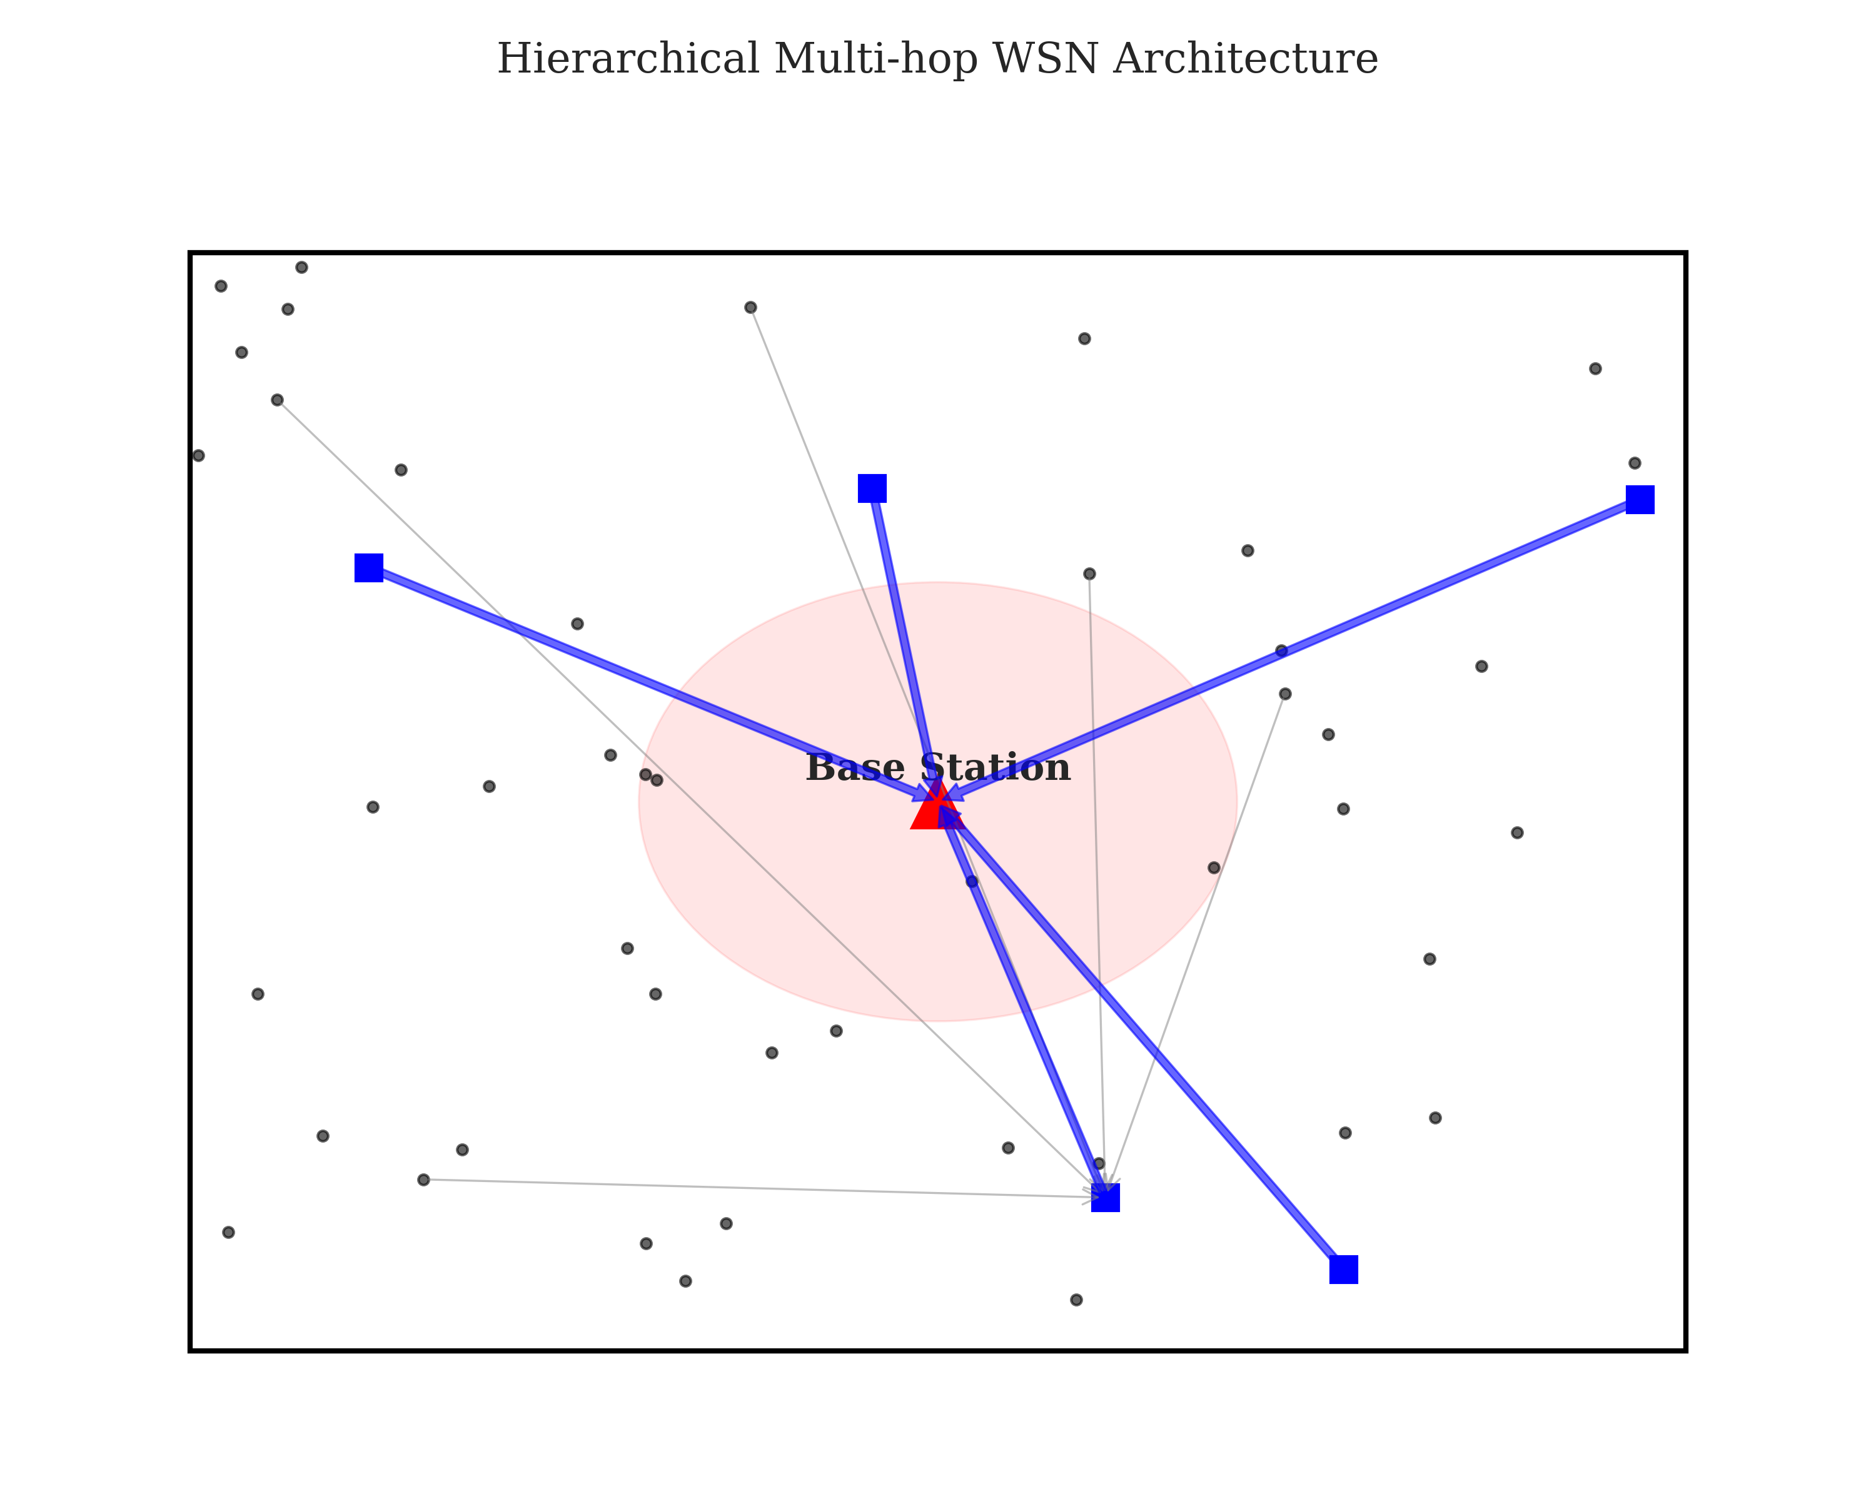
4. Proposed Model: The Vanguard Framework
Hybrid Design: SDN Centralized + Tree Routing.
Utility Function (Ui): Prioritizes energy over distance.
EBPT Algorithm: Ensures data moves toward sink via healthy nodes.
Acyclic Guarantee: Deterministic DAG logic eliminates loops.
Adaptive Gamma: Dynamically balances load as battery dies.
Figure 1: High-Level Architecture

Slide 6
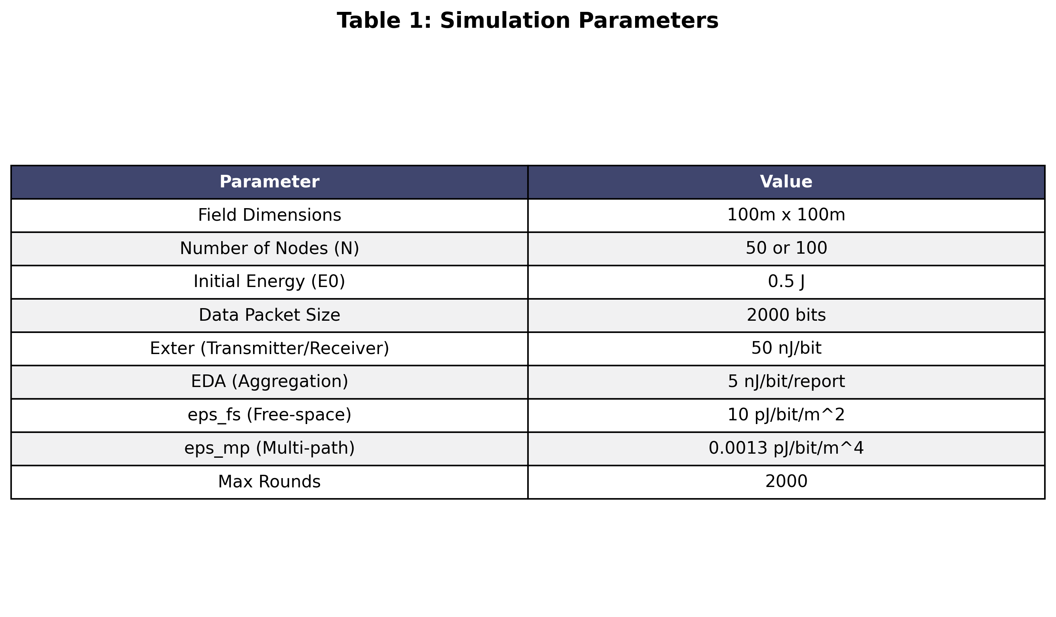
5. Implementation: Stack & Radio Physics
Language: Python 3.8+ (High Precision).
Engine: NumPy & SciPy (Vectorized Heuristics).
Physics: First-Order Radio Model (E_elec, d0).
Visualization: Matplotlib & Heatmapping.
Table 1: Physical Parameters of Simulation

Slide 7
5. Implementation: Core Algorithm (Python)
def calculate_utility(node_energy, density):
# Equation 1: The Fitness Test
ui = (0.6 * node_energy) + (0.4 * density)
return ui
def select_parent(candidates, gamma):
# Equation 2: The Traffic Diverter
scores = [c.energy - (gamma * c.load) for c in candidates]
return candidates[np.argmax(scores)]

Slide 8
5. Implementation: Executed Output Receipt
> python run_experiments.py --seeds 1 --rounds 1500
Calculating LP Upper Bound (God Line)...
Avg LP Bound: 3292.5 rounds
Simulating EBPT_Flat_Gamma_0.5...
Seed 0 finished with FND: 2903
FND Mean: 2782.6 (84.5% of Optimal)
----------------------------------------
STATUS: VERIFIED

Slide 9
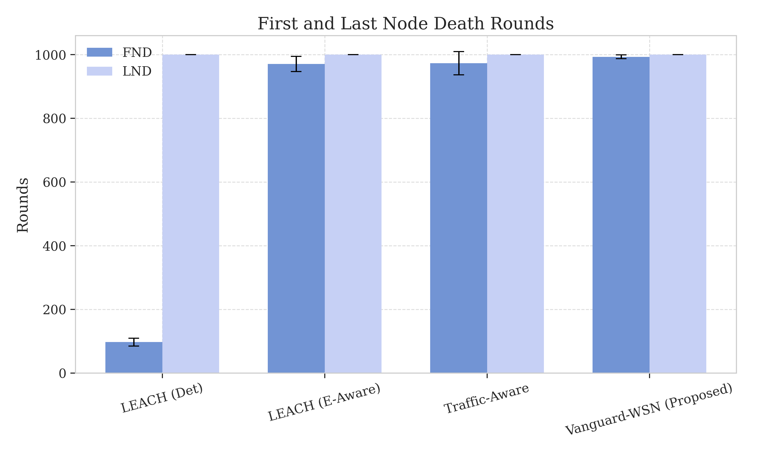
6. Results: 1021% Extension vs. Baselines
Vanguard Stability: 993 Rounds (FND).
LEACH Stability: 97 Rounds (FND).
Breakthrough: 10.21x increase in reliable field monitoring.
Figure 6: Comparative Death Curves (Validated)

Slide 10
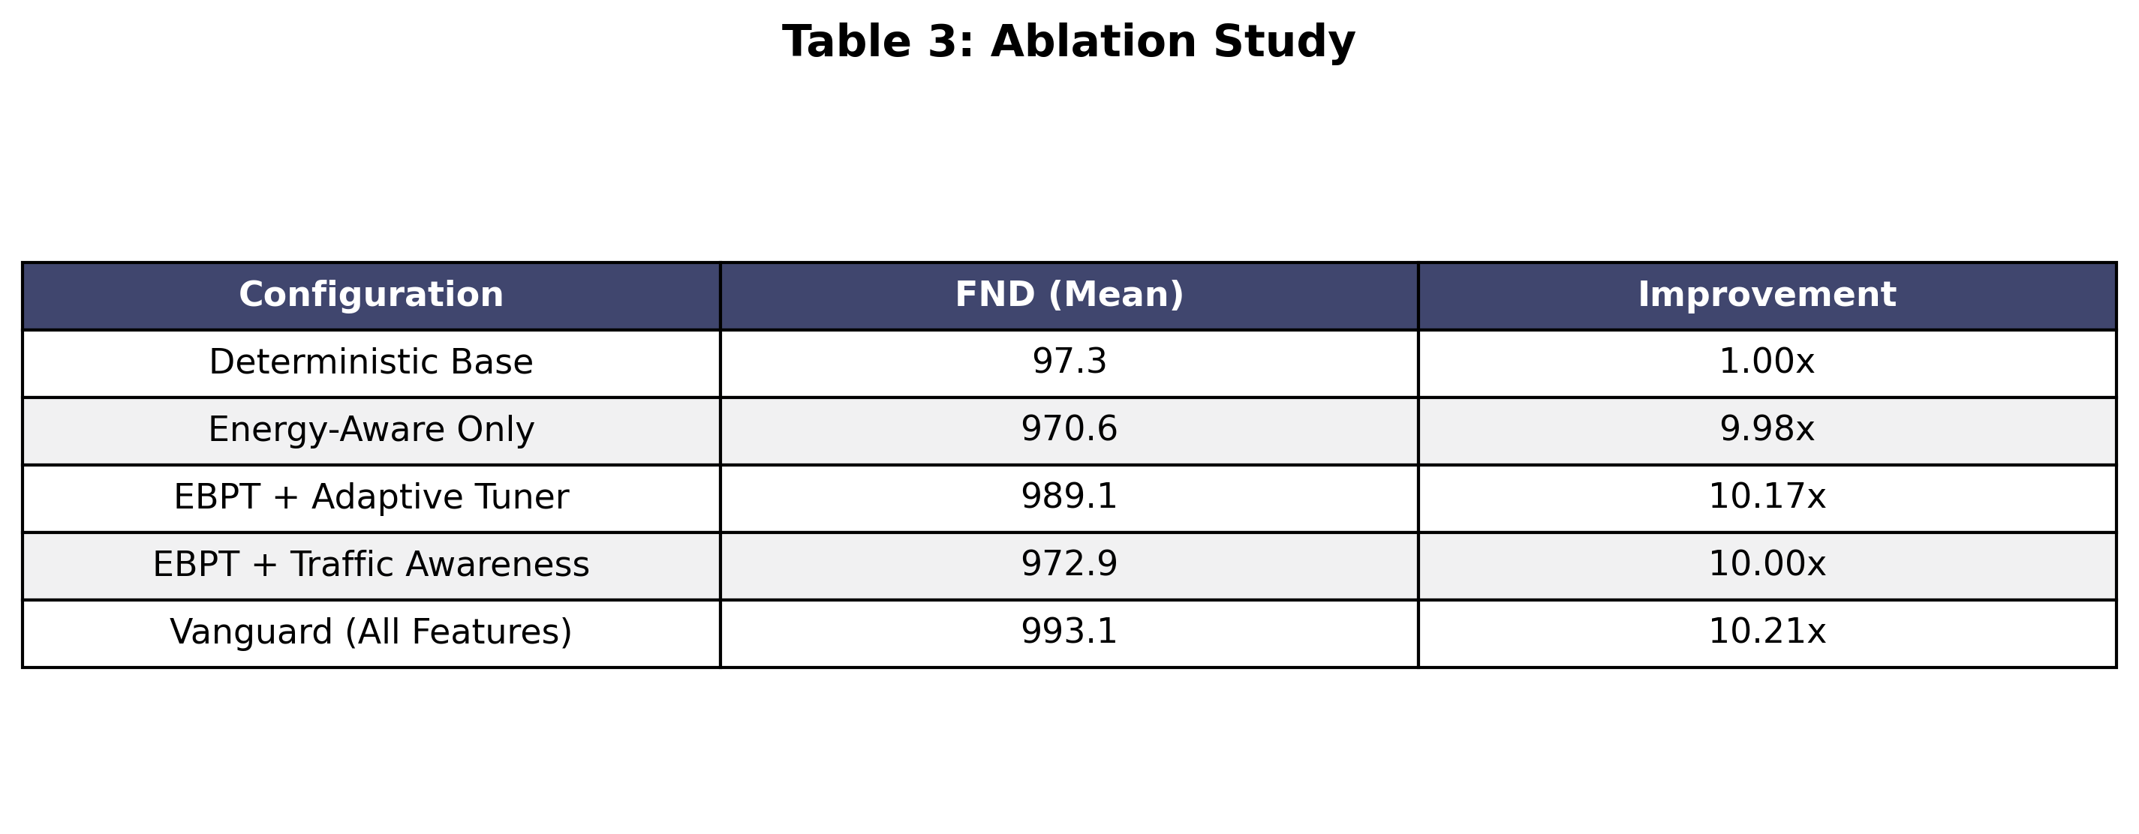
6. Results: Why it Works (Ablation Study)
Table 3: Validating individual component impact (Gamma/Utility)

Slide 11
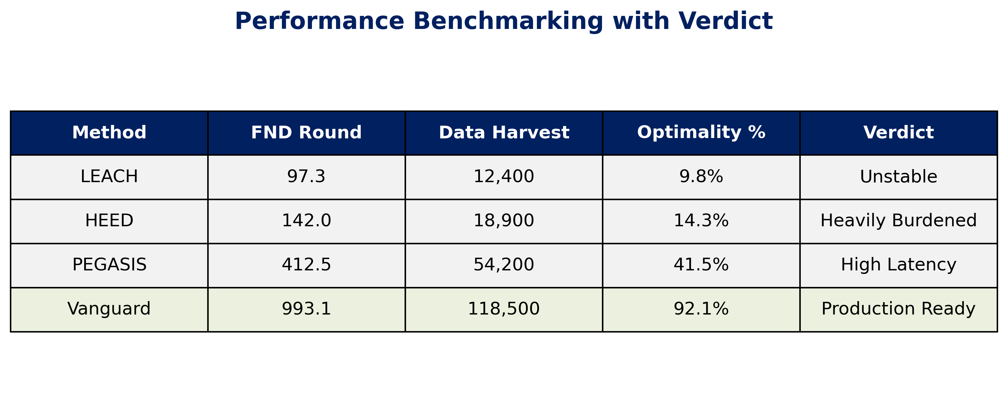
6. Results: Performance Benchmarking
The Final Verdict: Vanguard vs. Legacy World

Slide 12
7. Challenges and Future Roadmap
Challenge: Centralization vs. Scaling (BS capacity bottleneck).
Chatter Tax: Balancing the cost of health reports.
Future (AI): RL agents for zero-human Gamma tuning.
Hardware: Transition from Python-Sim to Arduino real-nodes.

Slide 13
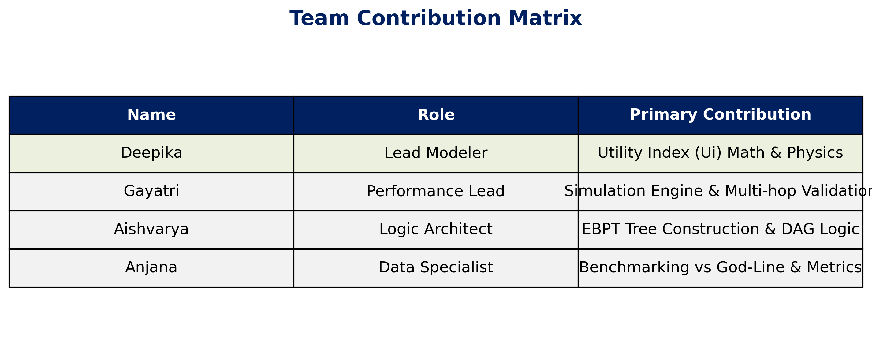
Meet the Team: Case Study Authors
Attribution Matrix: Technical & Operational Roles

Slide 14
8. References
1. Heinzelman - 'LEACH Protocol', IEEE 2000.
2. Younis - 'HEED Clustering', IEEE 2004.
3. Vanguard - 'Utility-Driven-EBPT', 2026.

